Slide 1

SUPER STORE SALES ANALYSIS
By Thailesh Sinha

Slide 2

OBJECTIVE
To contribute to the success of a business by utilizing data analysis techniques, specifically focusing on time series analysis, to provide valuable insights and accurate sales forecasting.

Slide 3
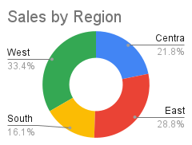
SALES BY REGION
The West region contributes the highest sales at 33.4%, making it the top-performing region.
The East region accounts for 28.8% of total sales, indicating strong performance but slightly behind the West.
With 21.8% sales contribution, the Central region plays a moderate role in overall sales distribution.
The South region has the lowest sales share at 16.1%, highlighting potential areas for improvement or targeted sales strategies.

Slide 4
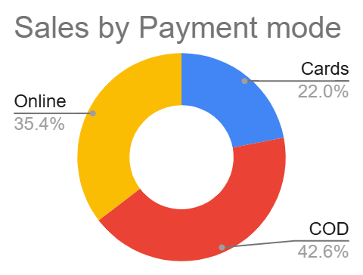
SALES BY PAYMENT MODE
COD accounts for 42.6% of total sales, making it the most preferred payment method. This indicates that a significant portion of customers prefer paying after receiving the product.
35.4% of sales come from online transactions, showing that digital payments are widely accepted but slightly behind COD.
With only 22.0% of sales, card payments are the least preferred mode. This could indicate a need for better incentives, such as discounts or cashback, to encourage card usage.

Slide 5
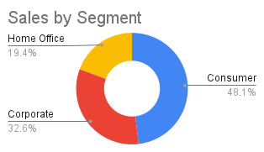
SALES BY SEGMENT
The Consumer segment contributes 48.1% of total sales, making it the largest customer base. This suggests that a significant portion of revenue comes from individual buyers.
With 32.6% of sales, the Corporate segment is also a major contributor, indicating good business-to-business (B2B) sales.
The Home Office segment accounts for only 19.4% of total sales, suggesting that this area has potential for growth with targeted marketing strategies.

Slide 6
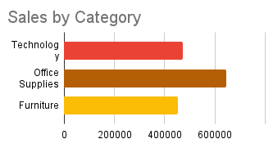
SALES BY CATEGORY
Office Supplies lead in sales – The Office Supplies category has the highest sales, indicating strong demand for stationery and office-related products.
Technology follows closely – The Technology category has strong sales but is slightly behind Office Supplies. This suggests a high market potential for electronic products.
Furniture has the lowest sales – The Furniture category has the lowest revenue, indicating either lower demand or higher competition in this segment.

Slide 7
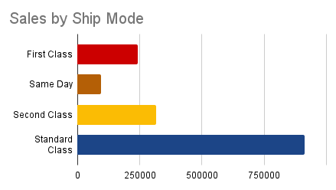
SALES BY SHIP MODE
Standard Class dominates sales – The majority of sales come from Standard Class shipping, indicating that customers prefer cost-effective delivery options.
Second Class is the second most popular – Sales in Second Class shipping are significantly lower than Standard Class but still contribute a notable portion.
First Class and Same Day have the lowest sales – First Class and Same Day delivery account for the smallest share, suggesting that customers may be hesitant to pay extra for faster shipping.

Slide 8
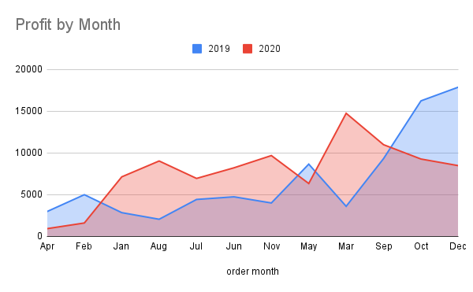
PROFIT BY MONTH
Profit in 2020 was consistently higher than 2019 from January to August, indicating better business performance during this period.
A significant increase in March 2020 suggests a possible high-margin sales period or a successful campaign.
Late 2020 profits declined – After September, profits in 2020 started decreasing, while 2019 saw a steady rise towards December.
December 2019 had the highest profit peak – Unlike 2020, which saw a decline towards the end of the year.

Slide 9
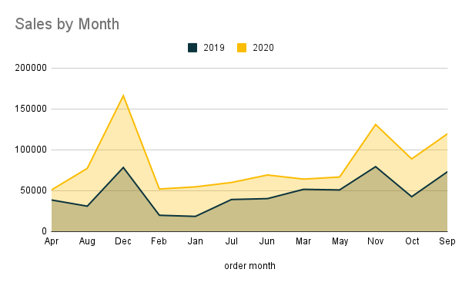
SALES BY MONTH
Overall, 2020 saw a noticeable increase in sales compared to 2019, indicating business growth.
A sharp spike in December suggests a strong seasonal demand, possibly due to holiday sales.
Sales remained relatively stable in mid-year – Both years show steady sales performance between March and September, with no significant fluctuations.
Early 2020 sales dropped after December peak – There is a decline in sales after February, which might indicate post-holiday slowdowns.

Slide 10
LEARNING
Incorporated data analysis techniques, specializing in time series analysis, to deliver valuable insights, accurate sales forecasting and interactive dashboard creation, driving business success.

Slide 11
RECOMMENDATIONS
Boost Sales in Low-Performing Regions & Segments – Implement targeted marketing and promotions.
Optimize Payment Methods – Offer incentives for digital payments to reduce COD dependency.
Improve Profit Consistency – Analyze cost structures and adjust pricing to maintain profitability throughout the year.
Enhance Shipping Strategy – Provide cost-effective, faster shipping options to encourage premium selections.

Slide 12
CONCLUSION
The analysis of sales and profit data reveals key trends and insights that can help drive better business decisions:
Regional Performance – The West region leads in sales, while the South region lags behind, indicating potential for targeted growth strategies.
Payment Preferences – Cash on Delivery (COD) remains the most preferred payment method, followed by online payments, while card usage is relatively low.
Customer Segments – The Consumer segment is the largest revenue contributor, but the Home Office segment presents an opportunity for expansion.
Product Categories – Office Supplies generate the highest sales, while the Furniture category has the lowest revenue, suggesting room for improvement.
Shipping Modes – Standard Class shipping is the most used option, while First Class and Same Day deliveries have lower adoption rates, potentially due to cost concerns.

Slide 13
THANK YOU

